Slide 1
BACKTRACKING
nQueen Problem

Slide 2
Methods()

Slide 3
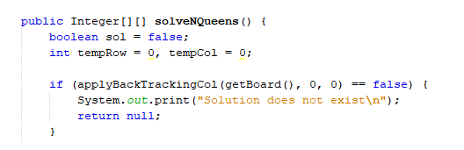
Solve N Queen()
It starts the function by calling backtracking.

Slide 4
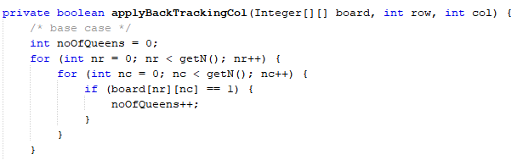
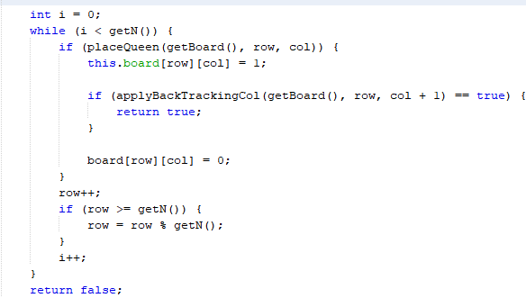
Apply Backtracking Column()
It either places a queen or removes it.
It is a recursive function which operates on Depth First Approach. It gives us the stopping criteria of the algorithm.

Slide 5
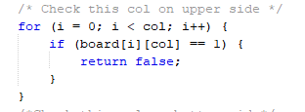
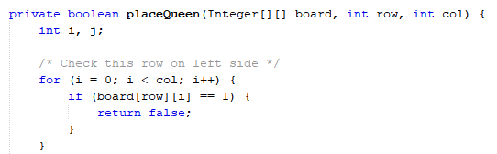
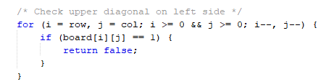
Place Queen()

Slide 6
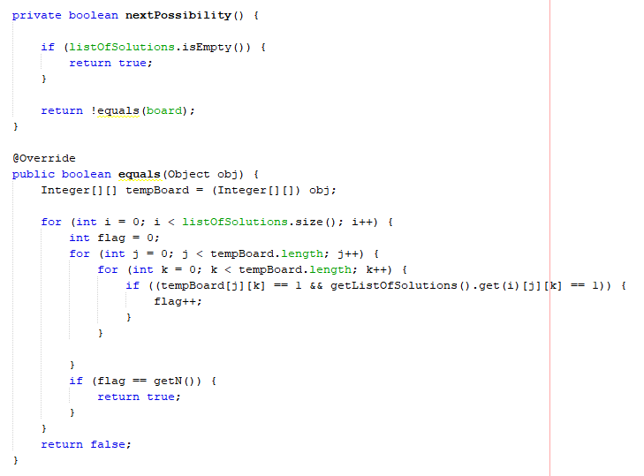
Next Possibility() and Equal()
It checks if the new board generated is used before or not.

Slide 7
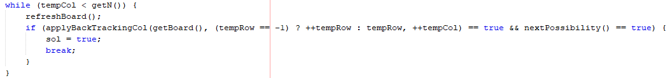
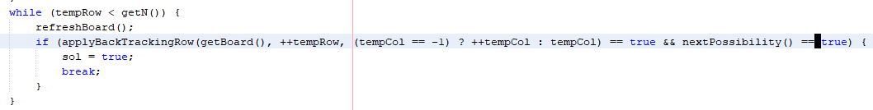
What if new board is already used?

Slide 8
OTHER CLASSES

Slide 9
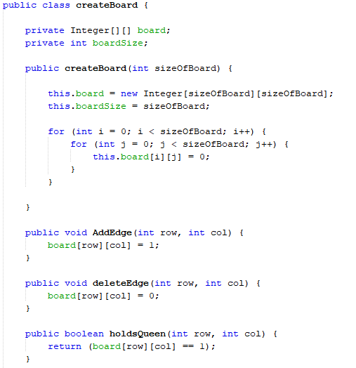
Create Board()

Slide 10
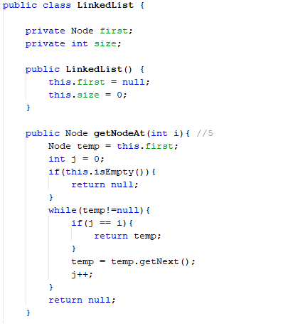
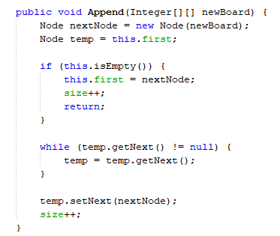
LinkedList()

Slide 11
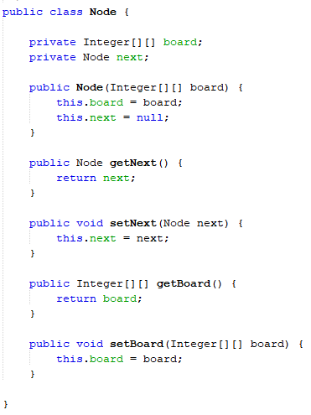
Node()

Slide 12
GENETIC ALGORITHM
nQueen Problem

Slide 13
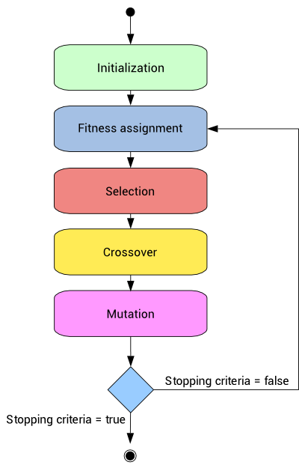
What is Genetic Algorithm

Slide 14
Methods()

Slide 15
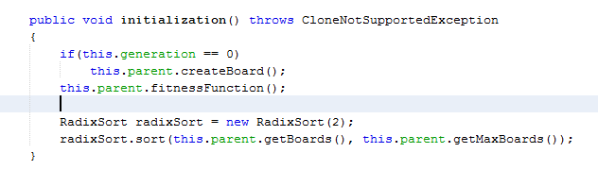
Initialization()
It does three things:-
It creates boards with random Queens positions to start the algorithm.
It gives fitness value to the parent population.
It sorts the parent population according to the fitness value.

Slide 16
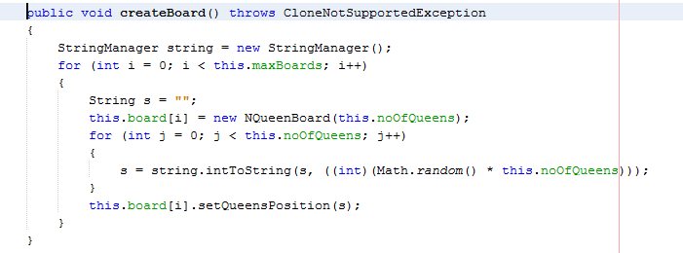
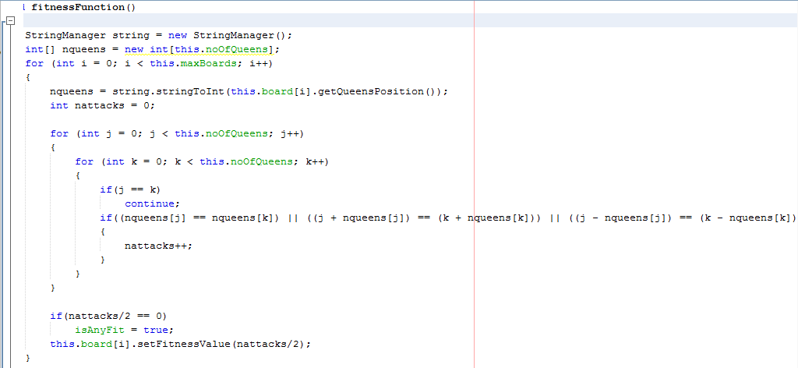

Slide 17
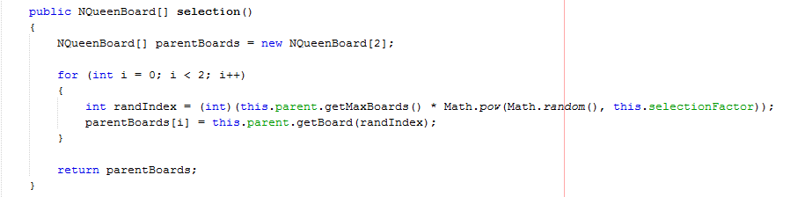
Selection()
It selects two parent boards randomly, according to the given selection factor.

Slide 18
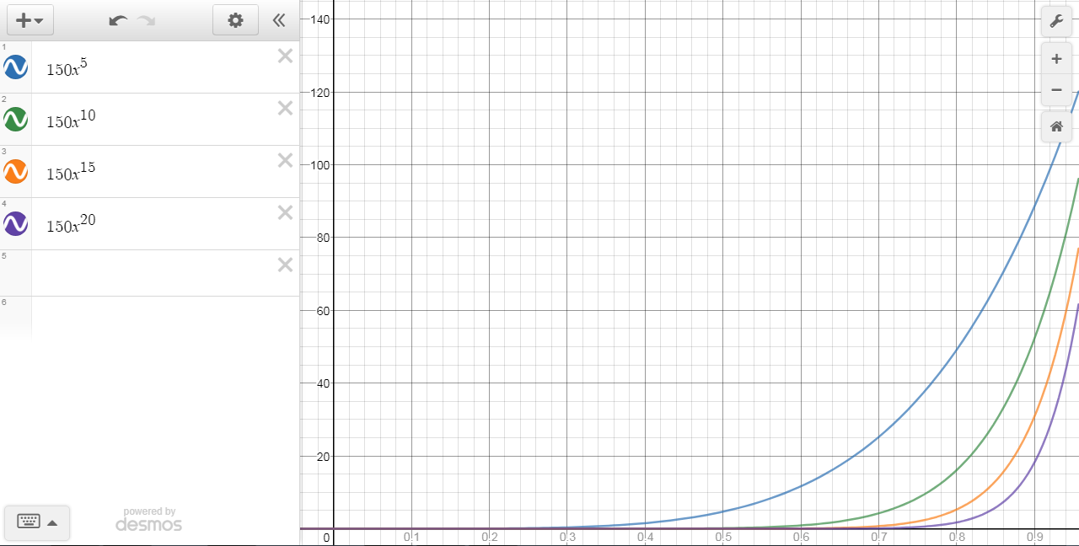

Slide 19
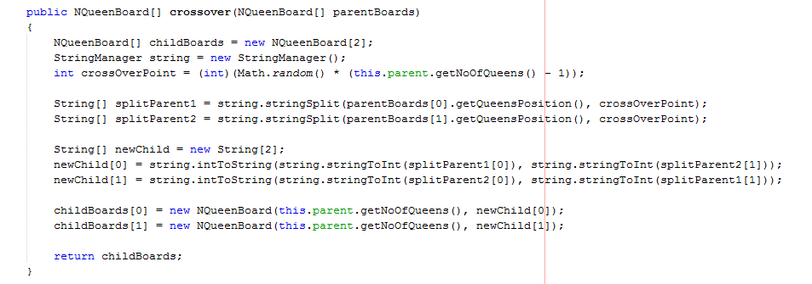
Crossover()
It does three things:-
It randomly generates the crossover point/position.
It splits the two parent boards given by selection method through crossover point.
It merges/swaps the split parts to creat two new child boards.

Slide 20
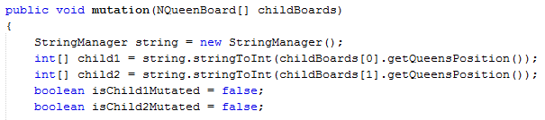
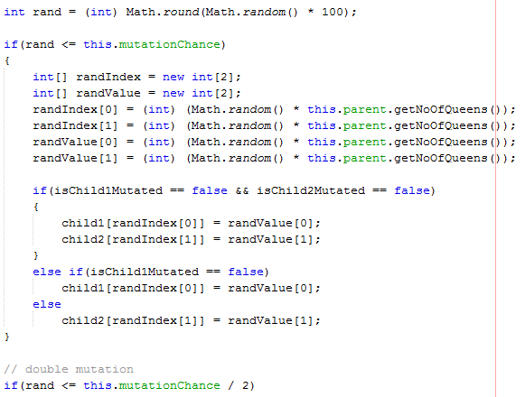
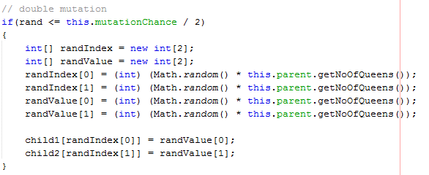
Mutation()

Slide 21
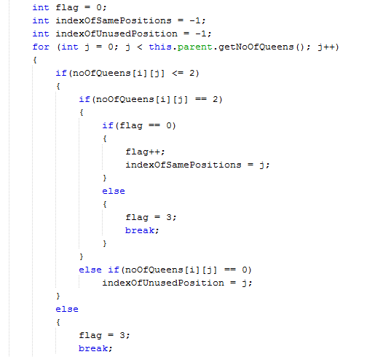

Extra Flair!!!
Unethical Mutation

Slide 22
OTHER CLASSES

Slide 23
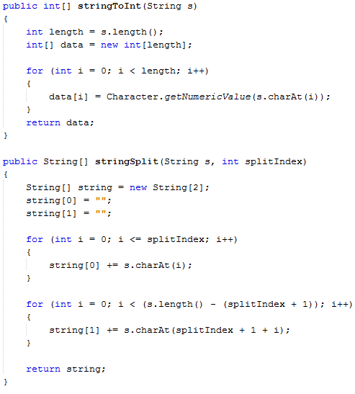
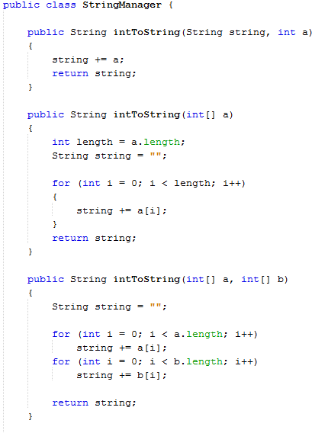
String Manager()

Slide 24
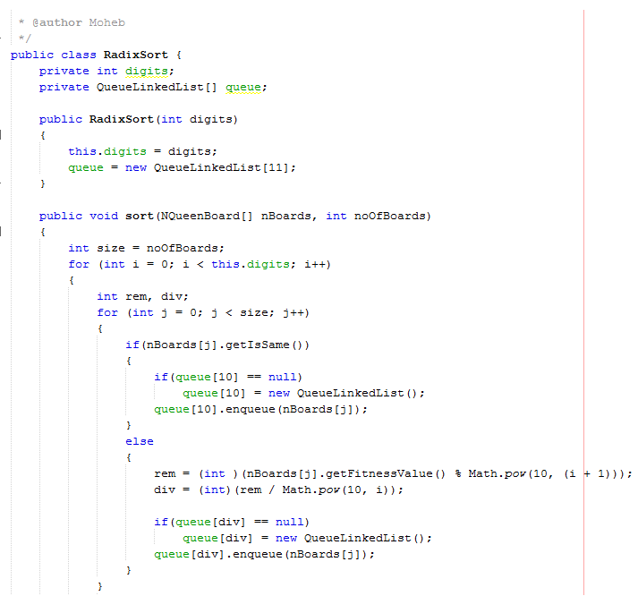
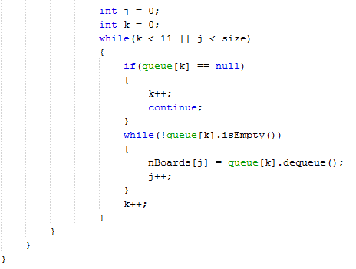
Radix Sort()

Slide 25
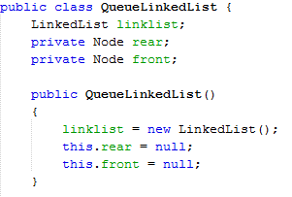
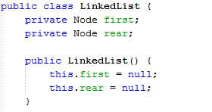
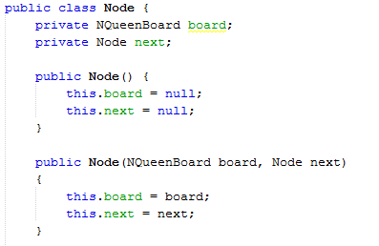
Queue Linked List()

Slide 26
THANK YOU

